Slide 1
TCP/IP
EN.600.444/644
Fall 2019
Dr. Seth James Nielson

Slide 2
IPv4 Protocol
Layer 3 Protocol
Handles fragmentation and reassembly
Assumed that across multiple LANS, multiple MAC protocols
Each MAC protocol might have its own MTU
Also, of course, includes the global IP address
Kind of global…

Slide 3
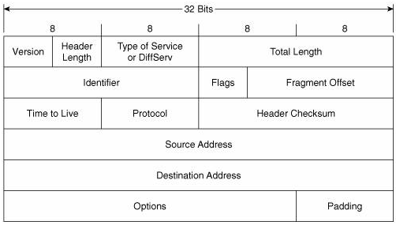
IPV4 Header

Slide 4
IPv4 Header FIELDS
Version – 0100 (binary 4)
Header Length – Length of header in 4-byte increments
Total Length – Size of header and data in bytes (max 65535)
Identification – for recognizing fragments
Flags
Reserved. Always 0
Don’t fragment
More fragments

Slide 5
More IPV4 Header Fields
Fragment Offset – Offset in original datagram
TTL – Counter to prevent infinite routing
Protocol – Information about upper layer (17=UDP, 6=TCP)
Header Checksum
Recomputed each hop (because of TTL changes)
Checksum field itself always presumed to be 0

Slide 6
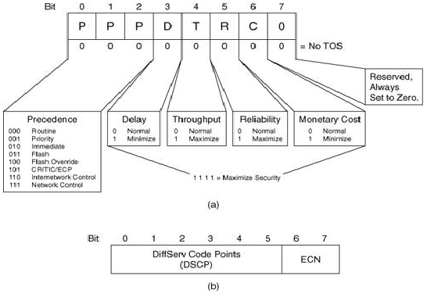
Original ToS

Slide 7
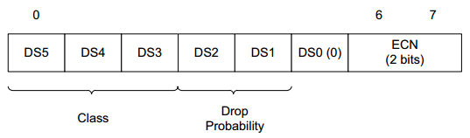
Differentiated Services

Slide 8
ECN
Explicit Congestion Notification
When enabled, indicates congestion without dropping
Not all hardware/software supports ECN

Slide 9
IPV4 Addresses
IPv4 Addresses are a.b.c.d where each is between 0-255
In actuality, just a 32-bit number (“four octets”)
192.0.2.235
3221226219
0xC00002EB (0xC0.0x00.0x02.0xEB)
Private Networks:
10.0.0.0
172.16.0.0
192.168.0.0

Slide 10
Fragmentation
If packet size > MTU, and DNF is 0
Each fragment gets its own size
Each fragment except the last gets MF set to 1
Fragment offset is location in the original packet
Identification field is unique identifier of original datagram
Reassembly
Use src, dst, protocol, and identification to identify fragments
Use offset to store data in reassembly buffer
Use MF = 0 to recognize end of reassembly

Slide 11
Fragmentation Issues
IPv4 Fragmentation had security issues
IP Fragmentation Overlap (overwrite a fragment)
Buffer full (too many incomplete fragments)
Fragment overrun
(Note that most of these are DoS, but some evasion)

Slide 12
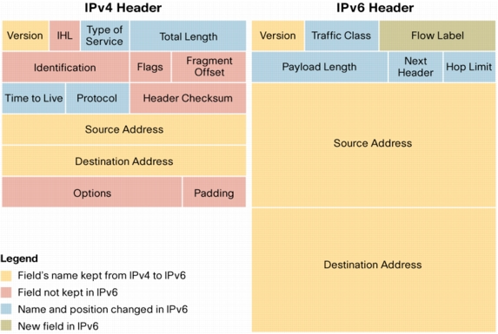
IPv6

Slide 13
IPV6 Header Fields
Version = 0110 (binary 6)
Traffic Class: Differentiated services plus ECN
Flow label: Hint for multiple outbound paths
Payload length: Includes extension headers, in bytes
Next header: Type of next extension or transport header
Hop limit: Decrement by 1, discard if 0

Slide 14
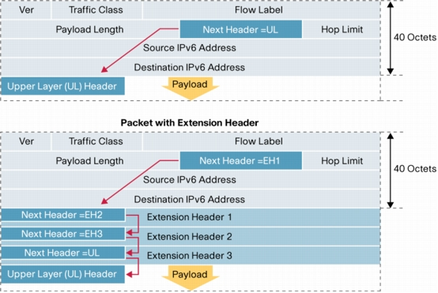
Extension Headers
IPv6 is always 40 bytes for main header
Can have additional headers:

Slide 15
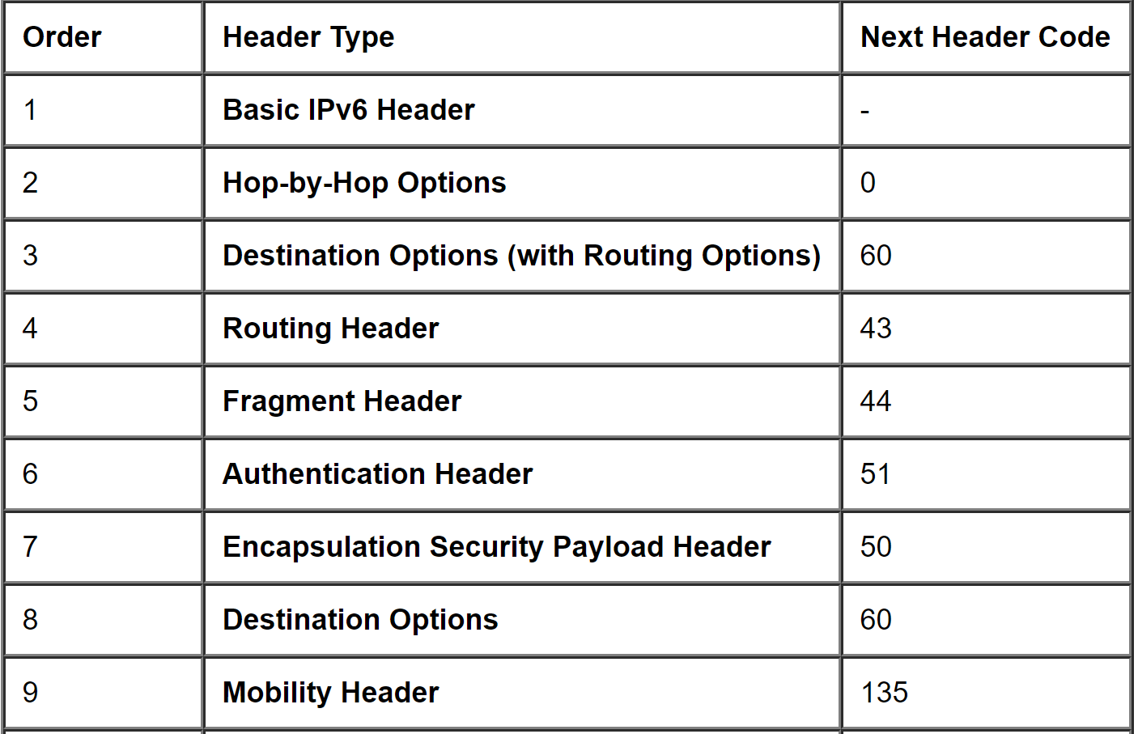
Common Extension Headers

Slide 16
IPV6 Fragmentation
To deal with IPv4 Frag issues, ONLY SENDER can frag in IPv6
Ergo, sender must know smallest MTU of path!
Path MTU Discovery (PMTUD)
If too big, send an ICMPv6 “packet too big” to sender
Otherwise, max IPv6 packet size is 1,280 bytes.
Uses a fragmentation extension header
Identification
MF, etc

Slide 17
IPv6 Frag Problems
Studies from 2014-present indicate IPv6 fragmentation fails
About one-third of IPv6 hosts could not receive frags
Many are concluding that IPv6 fragmentation is deprecated
Maximum IPv6 packet size between 1280 and 1350
See,
https://blog.apnic.net/2016/05/19/fragmenting-ipv6/
https://labs.apnic.net/?p=1033

Slide 18
TCP Protocol
Layer 4 Protocol
Multiplexing (ports)
Reliable Delivery (ack/resend)
Congestion control
Units called *segments*

Slide 19
Review
Ethernet frame
IP packet
TCP segment

Slide 20
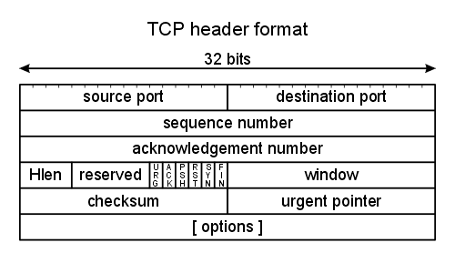
TCP Header

Slide 21
TCP Header FIELDS
Source Port, Destination Port for multiplexing
Sequence Number of the first data byte
Acknowledgement Number of next expected seq. no.
Hlen number of 32-byte words in the TCP header
Window number of bytes willing to receive
Checksum over the header and data

Slide 22
TCP Flags
URG The URGENT POINTER field contains valid data
ACK The acknowledgement number is valid
PSH The receiver should pass this data to the application as soon as possible
RST Reset the connection
SYN Synchronize sequence numbers to initiate a connection.
FIN Sender is finished sending data

Slide 23
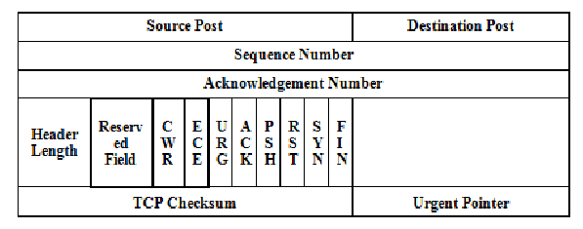
ECN Flags added in RFC 3168
Standard in 2001

Slide 24
TCP Flags (Cont)
CWR – Acknowledges that congestion notification received
ECN – indicates congestion notification via IP layer
(NOTE! Requires ECN capable IP layer!)
Sent until CWR received
Only used if negotiated using TCP options during handshake

Slide 25
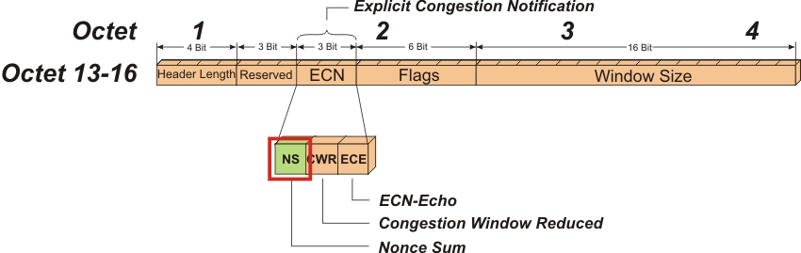
Optional NS flag

Slide 26
One-Bit Nonce
NS is a parity bit used to catch changes to a packet
Because it’s only one bit, a cheater can guess it 50% right
But, over repeated trials (frequent congestion) will get caught

Slide 27
TCP Options
Header can be “extended” with options
Each option can have up to three fields:
Option Type (1 byte)
Option Length (1 byte)
Option data (variable)
Examples include
Selective acknowledgement
ECN

Slide 28
TCP Sequence Numbers
TCP header has a value for seq num and ack num every time
SYN Sequence Number random between 0-4,294,967,295
SYN Ack Num should be 0 (but any value should be ignored)
SYN-ACK Seq Num also random
SYN-ACK Ack Num is SYN Seq Num + 1
(SYN-ACK) ACK Seq Num is SYN Seq Num + 1
(SYN-ACK) ACK Ack Num is SYN-ACK Seq Num + 1

Slide 29
Data Sequence Numbers
Technically, there is only one packet type in TCP
Flags simply indicate how the values can be used
Sequence number is set every time
But only increased by the length of the data
(or increased by +1 for SYN and FIN)
Ack field indicates that the ACK number is valid

Slide 30
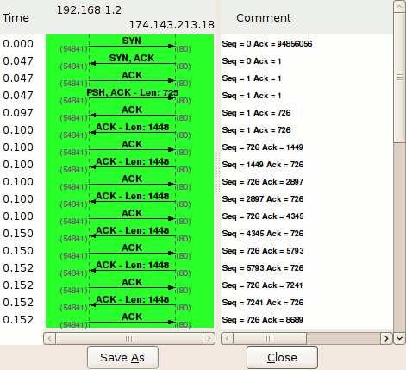
Wireshark Trace

Slide 31
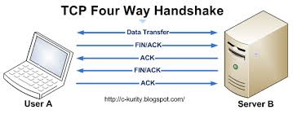
TCP Shutdown

Slide 32
Security
Obviously, TCP is not designed with security in mind
No confidentiality!
No authentication!
No integrity (checksum is not cryptographic)
No secure availability either!
End any connection with RST

